Slide 1

Abhijith Nidanakavi November 2023 MS Design/Thesis Project Defense ECE Department of Engineering Science School of Science and Technology Sonoma State University
Electrical and Computer Engineering
TruthSeeker: AI-Driven Detection of Fake & Propaganda Texts

Slide 2
Introduction - “TruthSeeker: AI's Role in Unmasking Fake and Propaganda Texts"
‘TruthSeeker’ leverages AI and ML to cut through the noise of the digital age, pinpointing truth within vast data.
Aimed at automating fact-checking, my project stands as a bulwark against misinformation, ensuring accurate content classification.
With 'TruthSeeker,' we empower informed decision-making, anchoring truth in the digital narrative.

Slide 3
Goal - "Mission: Steering Towards an Informed World"
In the digital jungle of information, primary goal is to bring clarity. We aim to filter out the noise of misinformation, enabling access to truthful and reliable content.
By harnessing the capabilities of AI, NLP, and ML, we're not just developing a tool; we're creating a guardian that stands against the tide of fake news and propaganda.

Slide 4
Research - Literature Review
www.sciencedirect.com/science/article/pii/S1877050920323966
https://ieeexplore.ieee.org/document/9978618
https://www.researchgate.net/publication/342745654_Detection_of_Propaganda_from_News_Articles_using_Deep_Learning
https://aclanthology.org/2020.semeval-1.226/
https://link.springer.com/article/10.1007/s40747-021-00393-y
https://www.researchgate.net/publication/322128415_Detecting_opinion_spams_and_fake_news_using_text_classification
https://www.semanticscholar.org/paper/Dataset-of-Propaganda-Techniques-of-the-Information-Chang-Lai/000e1bc628c0e9f4af7c70c029dbaf309cda6bc2#related-papers

Slide 5
Research - Literature Review
Previous research in misinformation detection primarily focused on developing advanced models. Emphasis on deep learning and machine learning techniques such as CNNs, and supervised and unsupervised methods were evident . This has been particularly evident in works aimed at enhancing clustering and classification capabilities.
Project Differentiator
'TruthSeeker' intends to broaden the scope beyond mere model architecture. I aimed to integrate a variety of embedding techniques — from traditional to cutting-edge — augmenting model development with enriched data representations.

Slide 6
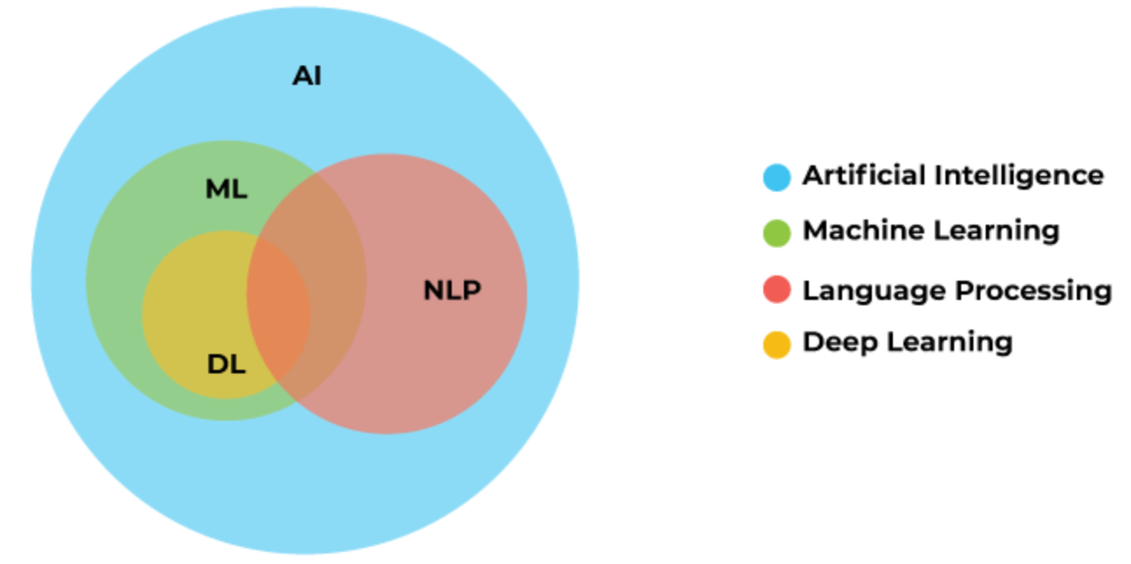
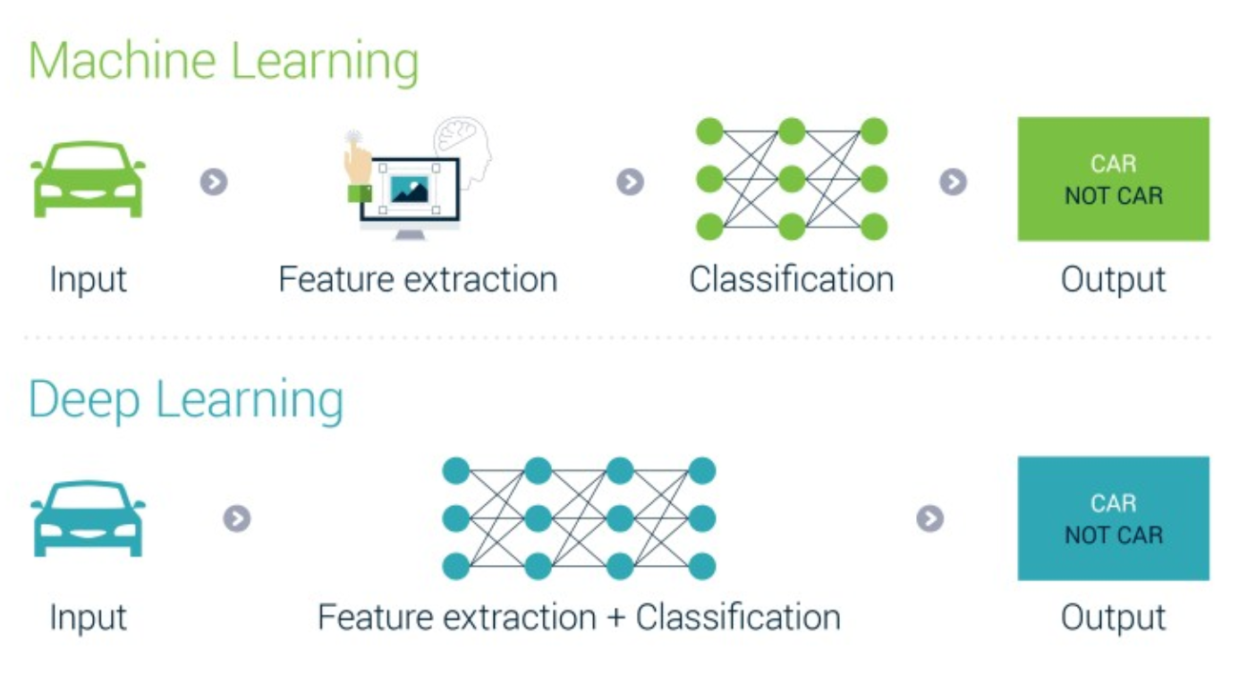
Theory - Machine Learning & Deep Learning – What is the difference ?

Slide 7
DATA
In the realm of data science, data reigns supreme as an indispensable asset that fuels analytical endeavors and drives insights.
For the realization of my project, a robust dataset from Kaggle, generously curated and uploaded by the esteemed corporation, “Zenodo”.
The dataset, christened ‘Corpus Proppy 1.0’, is a repository of rich textual content, housing an impressive array of 52,000 articles meticulously sourced from over 100 different news outlets

Slide 8
DATA
This treasure trove of data has been judiciously segmented into three distinct datasets.
The training dataset forms the backbone, infused with a wealth of 35,986 news articles.
The validation and test datasets, each boasting 5,125 news articles, to rigorously evaluate the model’s proficiency and adaptability.
In essence, ‘Corpus Proppy 1.0’ embodies a comprehensive and diverse compendium of data.

Slide 9
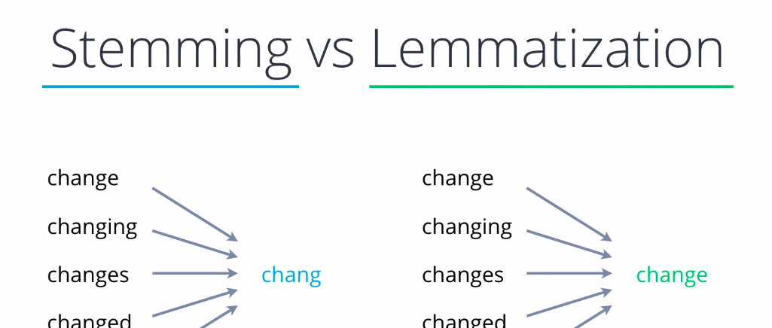
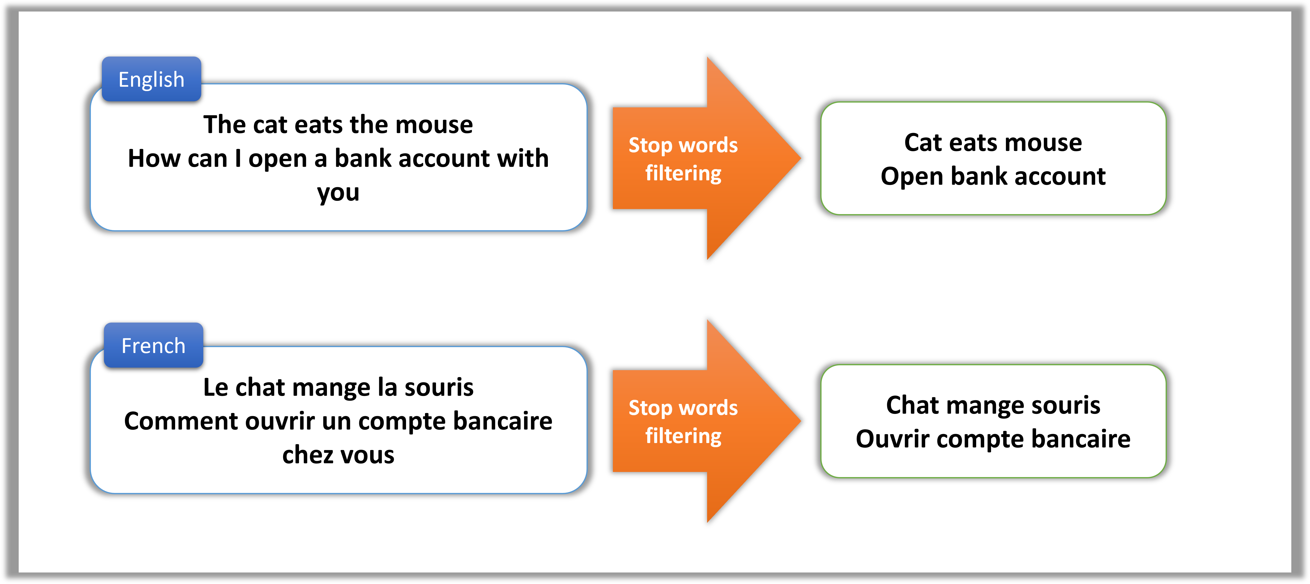
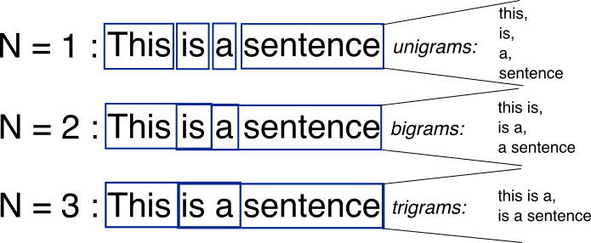
EDA
In the context of this project, the dataset is notable i.e., binary classification, arriving with predefined labels that categorize each entry as either 'propaganda' or 'non-propaganda’. As this pre-labeling acts as a form of initial preprocessing, serving to clarify and streamline the dataset by equipping it with explicit categorical markers.

Slide 10
Feature Engineering:
Techniques in Play: Tokenization, Vectorization & Word Embeddings
LDA
ELMO
Word2Vec
Bag of Words
NMF
BERT
TF-IDF
Word2Vec (Google News Vectors)
10

Slide 11

Modeling - ML
ML Arsenal : ML modeling began with a suite of basic yet powerful algorithms, each offering unique strengths in text classification.
XG BOOST
Naive Regression
Logistic Regression
Light GBM
11

Slide 12
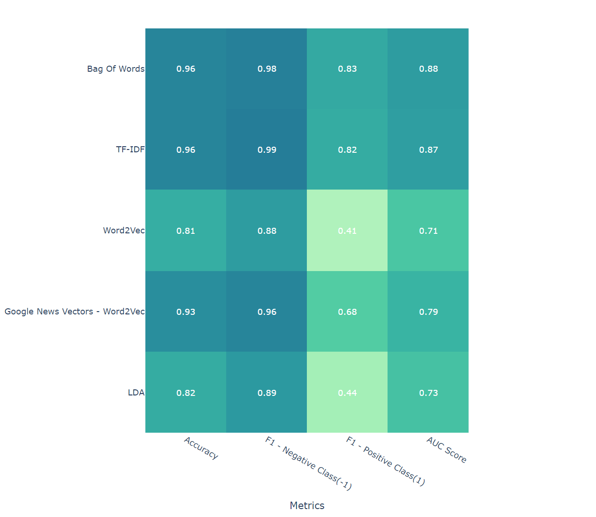
Modeling - XGBoost Leading the Charge
XGBoost emerged as a frontrunner. It's a gradient boosting framework is not just fast but also incredibly efficient at handling various types of data.

Slide 13
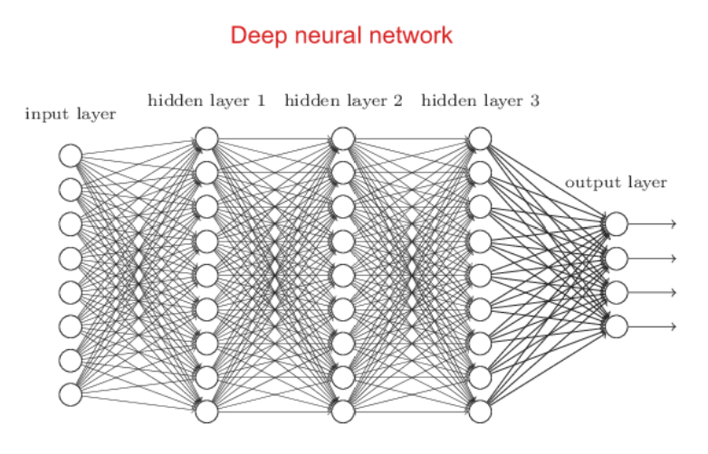
Modeling - DL
Harnessed a variety of models, each bringing unique capabilities to text classification challenge.
BERT
Distil BERT & RoBERTa
Convolutional Neural Networks (CNN)
Recurrent Neural Networks (RNN)
LSTM
Bi-directional LSTM
GRU
XL NET
13

Slide 14

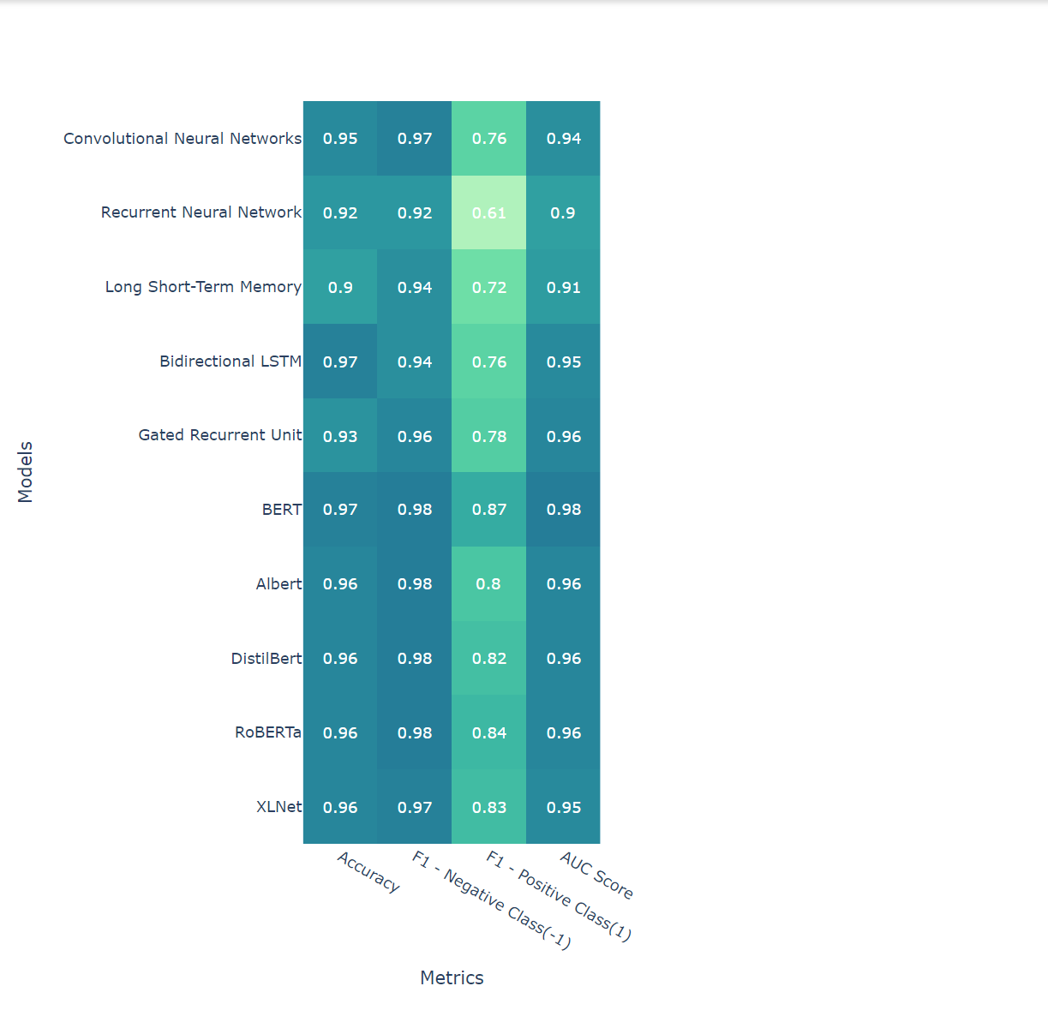
Modeling - BERT - The Champion
BERT (Bidirectional Encoder Representations from Transformers) emerged as the most effective model. Its transformer architecture allowed it to capture a deeper, more nuanced understanding of language context and flow.
Why BERT? "BERT's ability to process words in relation to all other words in a sentence (rather than sequentially) gives it an edge in capturing the subtleties and intricacies of language, making it a powerhouse in our deep learning arsenal.

Slide 15
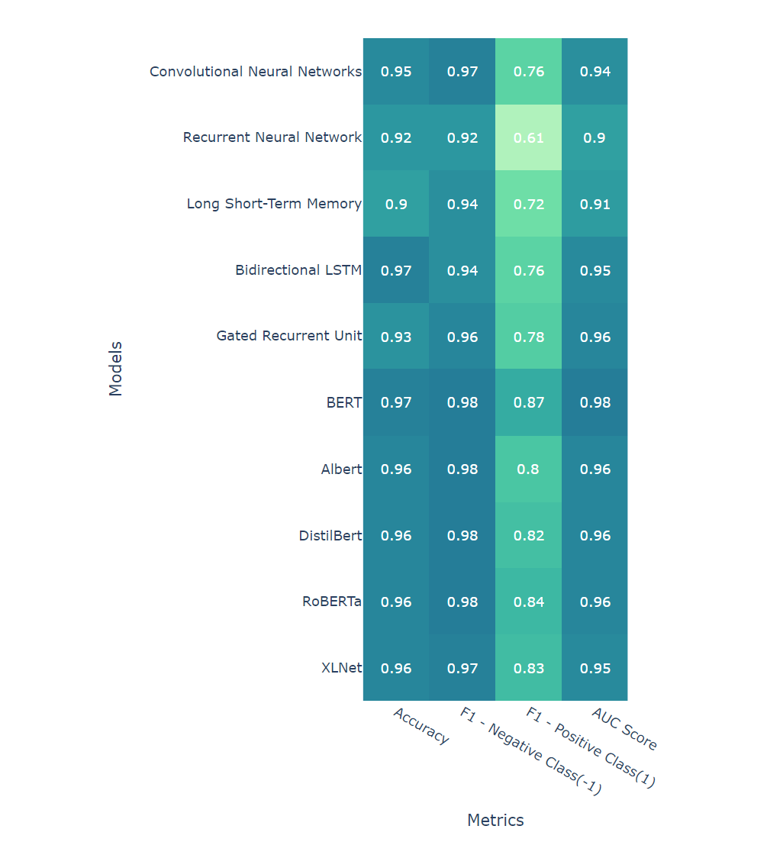
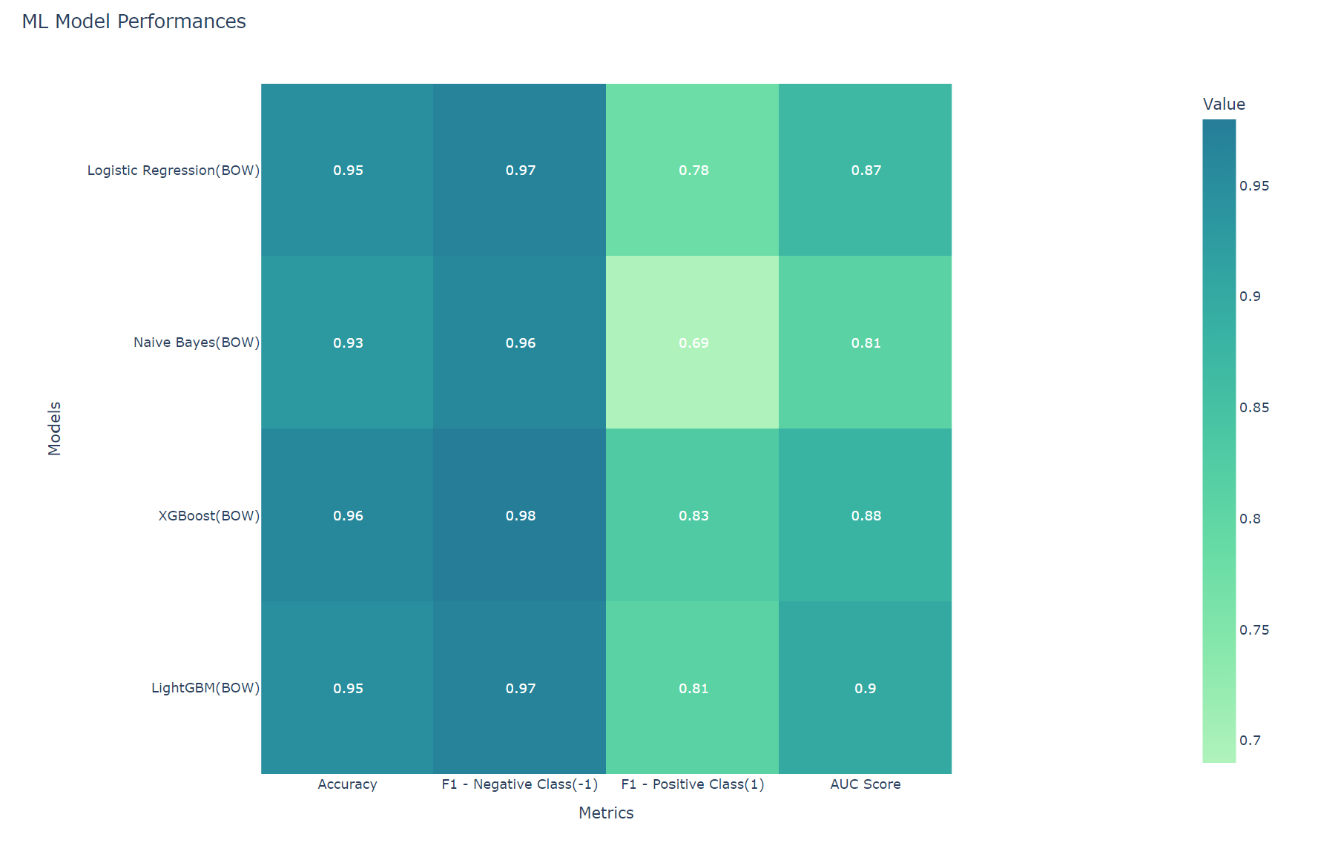
Comparative Analysis - Results
ML & DL Comparative Analysis

Slide 16
Design Project- Architecture
Model Architecture
Pre-processing
Feature Engineering
Modeling
(AI-ML & DL )
Choose the best model based on comparative Analysis among ML & DL
Deployment
DATA
16

Slide 17
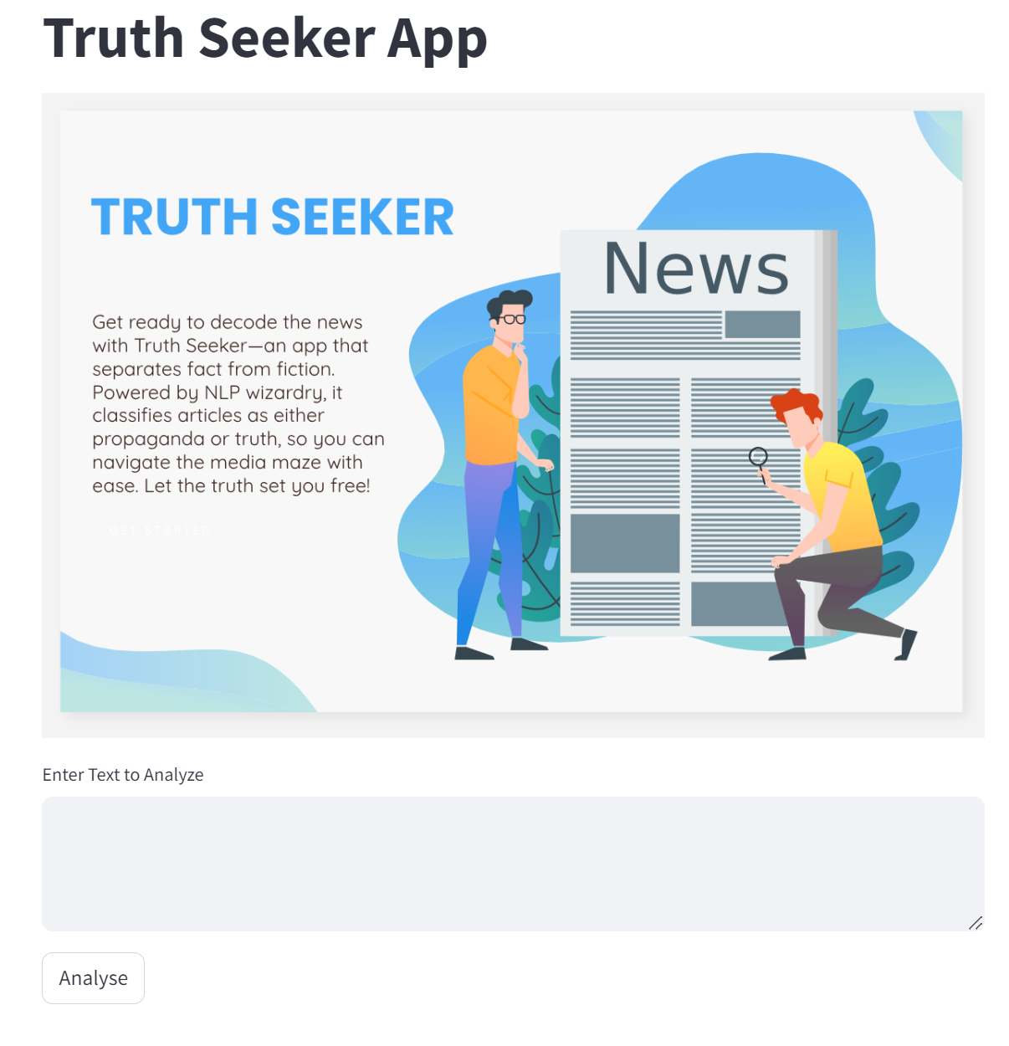
Deployment – GitHub & Streamlit Cloud
Deployed the propaganda detection model using Streamlit and hosted it on Streamlit Cloud. The project's code is on GitHub for version control and collaboration. This ensures user accessibility, security, and easy maintenance.
Streamlit Application : Created a user-friendly web app using Streamlit, allowing users to check articles for propaganda easily.
Streamlit Cloud : My app is hosted on Streamlit cloud for accessibility via weblink eliminating complex setup.
GitHub Repository : The code is stored on GitHub for version control, collaboration & transparency.

Slide 18
Future Work
CI/CD: Continuous Integration and Continuous Deployment will automate updates.
Access Control: Security measures will be in place for privacy and data protection.
Monitoring: Regular checks will be done for performance and reliability.
User Accessibility:
End Users: Can access the tool via a web link.
Collaborators: Collaborative development on GitHub with version history.
Researchers: Transparency and academic collaboration.
This approach ensures our tool's accessibility and reliability.
Conclusion:
Deployment connects innovation to impact, making my tool accessible and reliable.

Slide 19
Demo
https://truthseeker-an-app-that-separates-facts-from-fiction.streamlit.app/

Slide 20
QUESTIONS
… I am forever a student, with miles to journey and much to learn.

